Slide 1


SSS
Movies
Build Your Own Entertainment World

Slide 2
WELCOME
KIPM COLLEGE OF ENGINEERING AND TECHNOLOGY
GIDA GORAKHPUR
MINI PROJECT
Movie Website
SUBMITTED BY :-
SUBMITTED TO :-
MR. VIVEK PATEL
SAKET KUMAR
SHIVAM GUPTA
SIDHARTH SINGH
SRI HARI

Slide 3
TOPIC :-
MOVIE WEBSITE
SSS
Movies
Build Your Own Entertainment World

Slide 4




OUR TEAM
SAKET
SHIVAM
SIDHARTH
SRI HARI
Hello I am Saket from KIPM college. This website is developed by me, hope you like it.
Hello I am Shivam from KIPM college. And I am collaborator of this site. Hope you like it.
Hello I am Sidharth from KIPM college. This website is designed by me, hope you like it’s interface.
Hello I am Sri Hari from KIPM college.
I collected all the required information regarding this site.
Notes:
<a href="https://storyset.com/work">Work illustrations by Storyset</a>

Slide 5

INTRODUCTION :-
SSS Movies is web series and movie website,
In today’s revolutionary world everyone want some entertainment in their life by playing games, watching movie and some extra activities. But they don’t want to spend their money in such type of specs. So we launched our movie website named “SSS Movies”.
Here you can download any latest movie and web series in free or without any subscription or cost. In other side they want VPN(Virtual Private Network) to access and give many number of Ads, in our website you will not get any type of anonymous Ads, basically it’s user friendly .

Slide 6

Purpose of Movie Website ?
To see today’s environment many person are suffering from financial condition. So, we made this website that they can easily watch any movies in free.
Today’s busy life everyone don’t have much time for visit in cinema hall and buy tickets. So, they prefer mostly watching movies online. Also minimize your ticket and transportation cost.
In today’s trend movies website engage more traffic. So, according to this we made this website also which can grow easily.
You can create your own favourite movie collections.

Slide 7
BENEFITS OF OUR WEBSITE
01
02
03
No VPN Required.
24x7 Availability
Fast Server Speed
04
05
06
No Login Required
Privacy
No Ads
No need of any type of additional VPN to access.
You can easily access at any time.
Fast access and downloading speed ever.
No login required so easy to use.
High level security because of no sign up and login.
Easy user interface without any Ads.

Slide 8

When we also have to download Movies and Web Series from any other website we face many problems like: (i) Lots of Advertisement(ads). (ii) Time taking process. (iii) Open many unuseful tabs. (iv) VPN required. (v) Ask for Login or signup. (vi) Not all movies available. (vii) Visit here and there.
What Problem We Faces?

Slide 9


WHY MOVIE WEBSITE ?

Slide 10
Concept 1
Concept 2
Because peoples want entertainment in their life , and movies are one of the good choice with them.so we choose .
Easy to use , and mostly use by all type of users .
Concept 3
In todays trend movie website engage more traffic , and have some future in entertainment world.

Slide 11

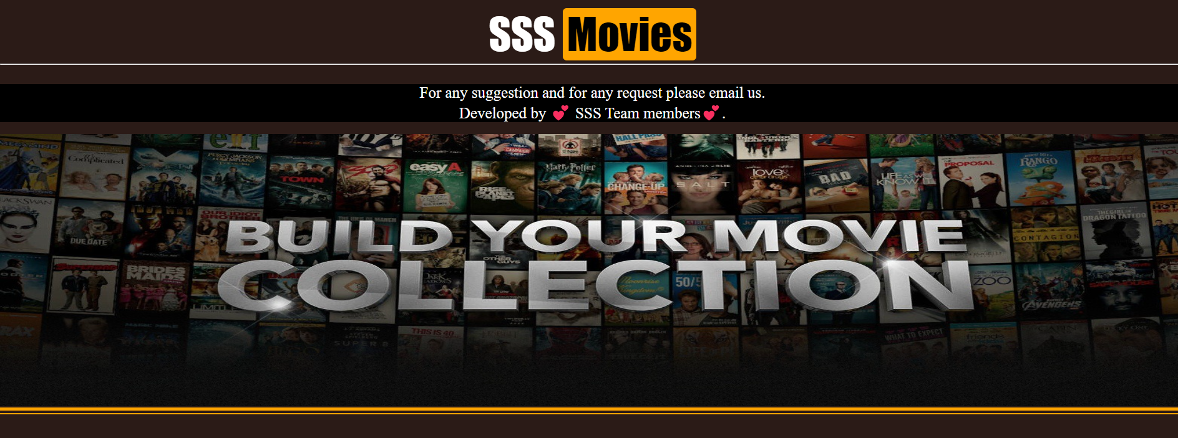
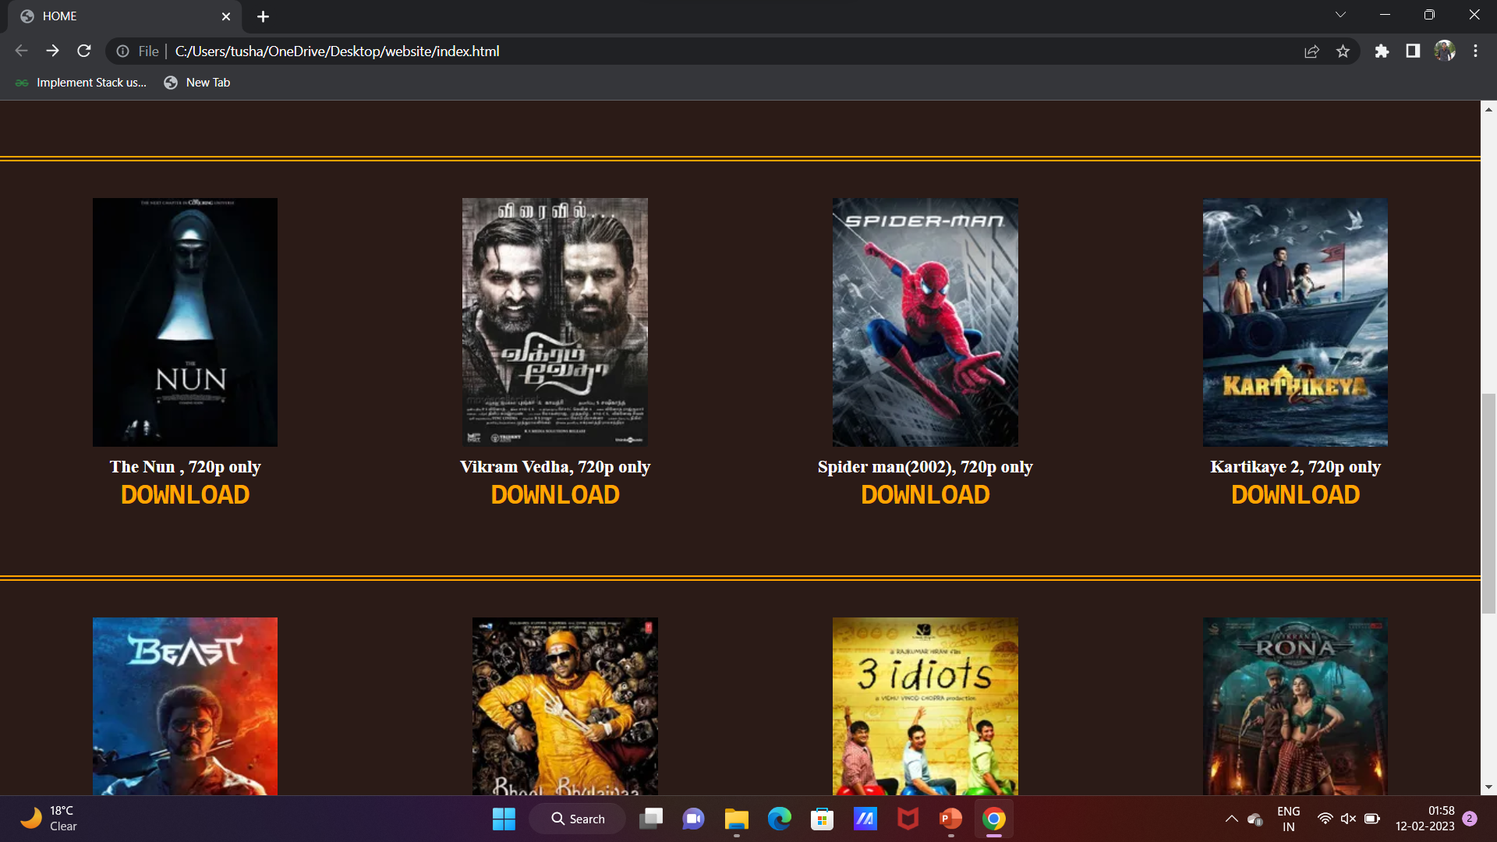

Layout of Website

Slide 12
How You Can Access ?
Step 1
Step 2
Step 3
Step 4
You must have any operating system
Search for our website Over internet
Look for your own movie choice
Download and enjoy

Slide 13
FUTURE OF THE PROJECT
Education
Music
Quality
In future we merge this website with education sectors.
In future we add also music system , so people can easily access.
We increase the quality and quantity of the conents.

Slide 14

—SOMEONE FAMOUS
Entertainment is there to improve people’s quality of life. After your basic needs, there’s entertainment.
लोगों के जीवन की गुणवत्ता में सुधार के लिए मनोरंजन है। आपकी बुनियादी जरूरतों के बाद मनोरंजन है।

Slide 15
THANKS!
Do you have any questions?
Saket (saket121122@gmail.com)
Sidharth (tushar15463@gmail.com)
Shivam (sg2672608@gmail.com)
Sri Hari (ujjwalgupta123@gmail.com)
Also follow us on :-

